Slide 1
BUILDING A PRIVATE CLOUD (Building PaaS using IaaS)
Presented by:
Lohitha Yenugu
Rahul Dhamerla

Slide 2
Problem Statement
To explore the possibility of designing an efficient Cloud framework for optimal utilization of storage space, improved resource availability and load balancing across the cluster of nodes.

Slide 3
Solution
Developing a system on which:
Users can create or destroy the cloud services like web servers and databases by using web client on demand.
Users can configure the memory and CPU usage of a service.
Users are billed according to the usage of resources.

Slide 4
Platform/Tools/Languages
Docker
Docker Swarm
Cloud Lab
Rest API
JSP
MongoDB
Net Beans IDE, Postman

Slide 5
System Architecture
HTTP REST API
MongoDB
JSP
Browser
Docker Swarm
Docker
Cloud Lab Node
Docker
Cloud Lab Node
Docker
Cloud Lab Node
Docker
Cloud Lab Node

Slide 6
Updates from Mid-Progress
POST Docker REST API
MONGODB – Database Creation, Insertion, Updating and Deletion.
Backend Server Programming
Orchestration- Docker Swarm
Web Interface

Slide 7
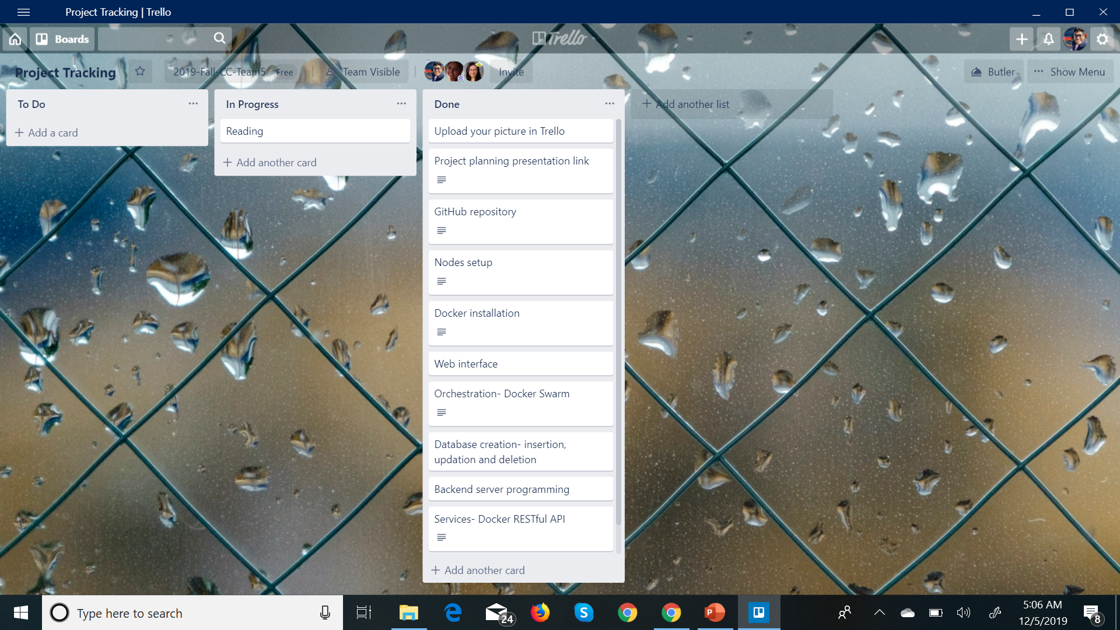
Project Progress

Slide 8
Screenshots

Slide 9
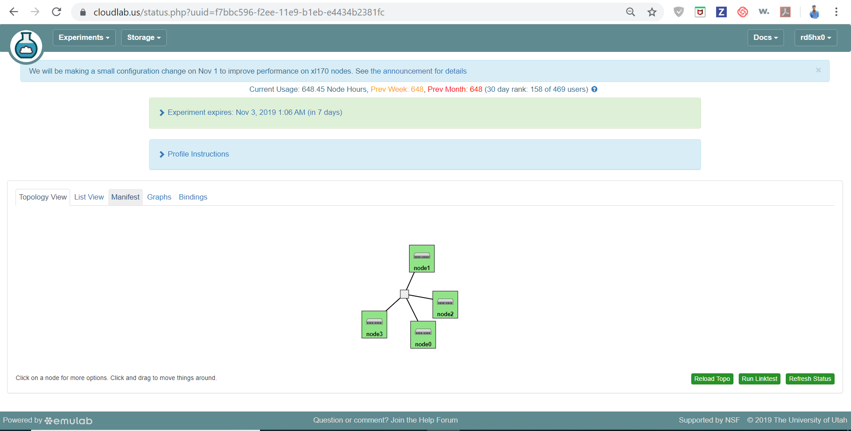
Nodes setup

Slide 10
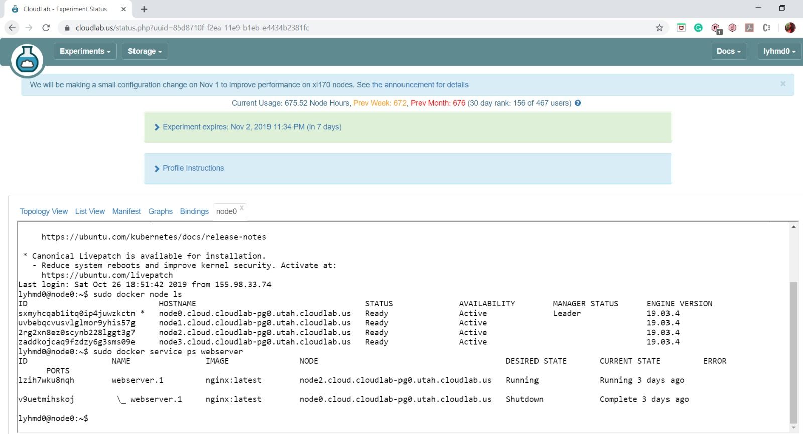
Docker Swarm

Slide 11
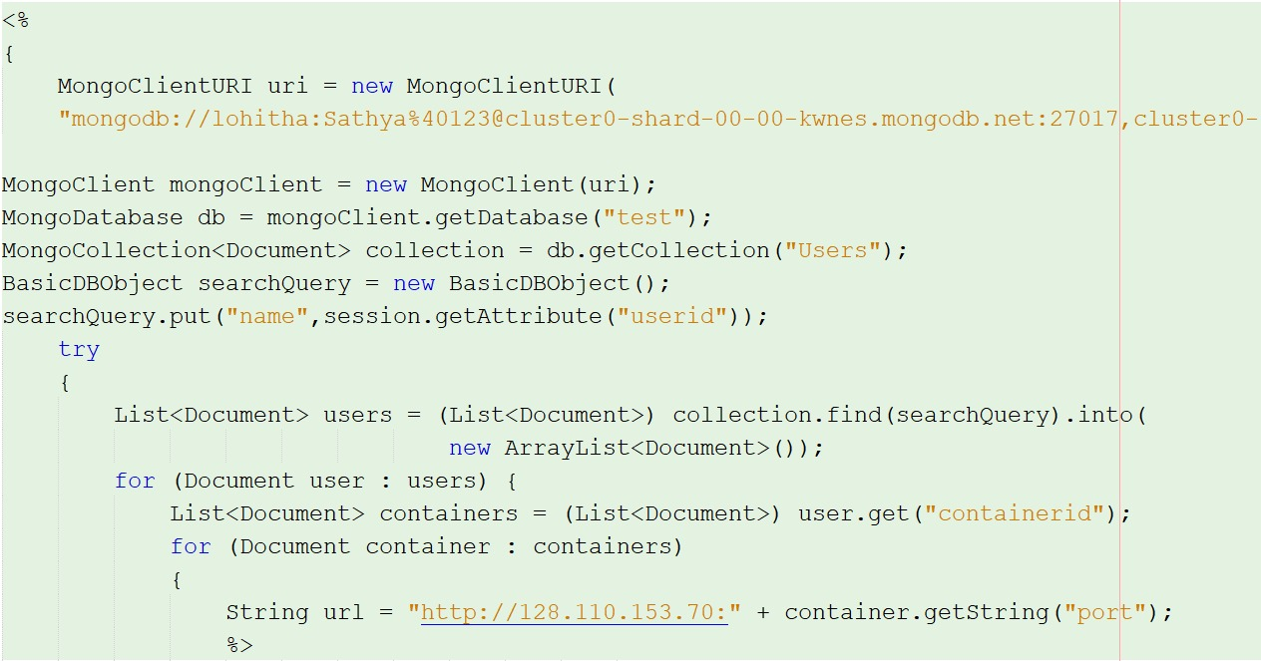
Code Snippet - MongoDB

Slide 12
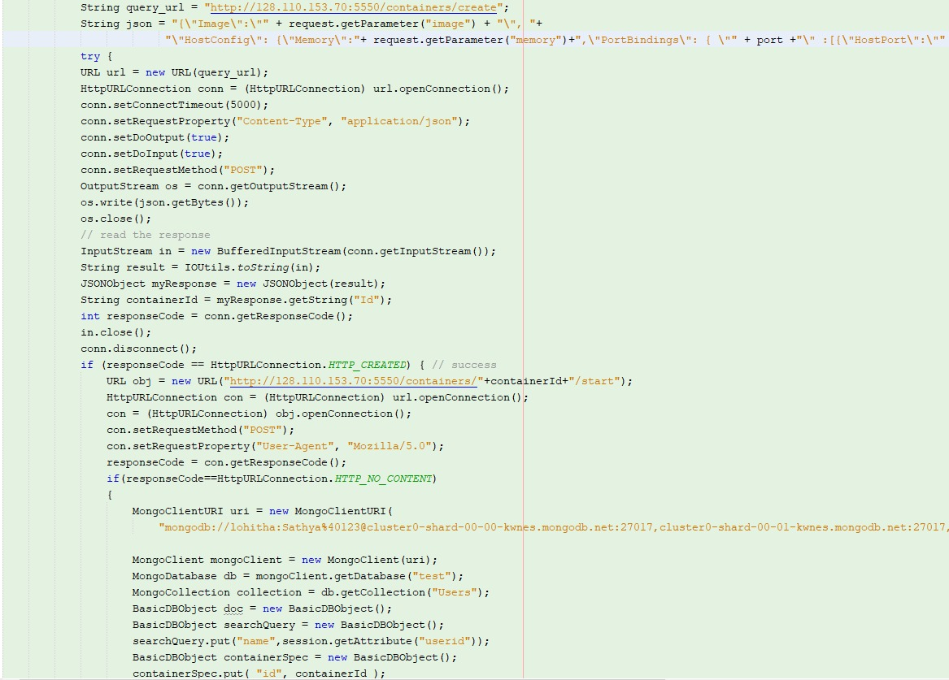
Create Container

Slide 13
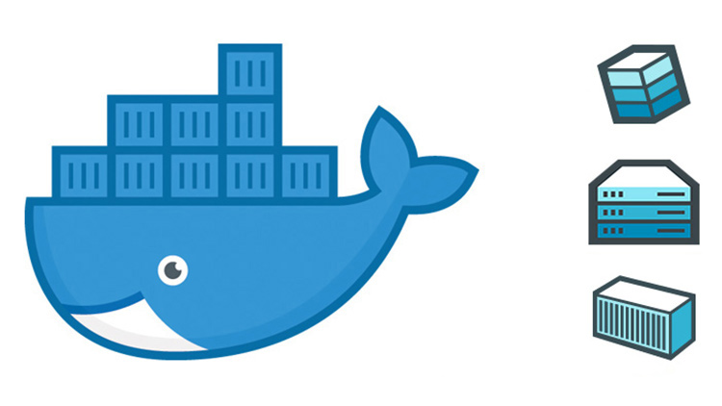
Project Demo
https://www.youtube.com/watch?v=rU-d7t5pJK4&feature=youtu.be

Slide 14
GitHub
https://github.com/rahuldhar123/2019-Fall-CC-Team-5-Building-a-private-cloud

Slide 15
Future Enhancements
User billing according to the usage of the resources.
Providing other services apart from Nginx and MongoDB.

Slide 16
Issues Faced
Container Orchestration using Docker Swarm.
Working with Docker Rest API calls.

Slide 17
References
https://docs.docker.com/engine/api/v1.24/
https://docs.docker.com/engine/swarm/swarm-tutorial/create-swarm/
https://www.thepolyglotdeveloper.com/2019/01/getting-started-mongodb-docker-container-deployment/
http://www.mongoing.com/docs/reference/method/js-collection.html

Slide 18
Thank You

